Slide 1
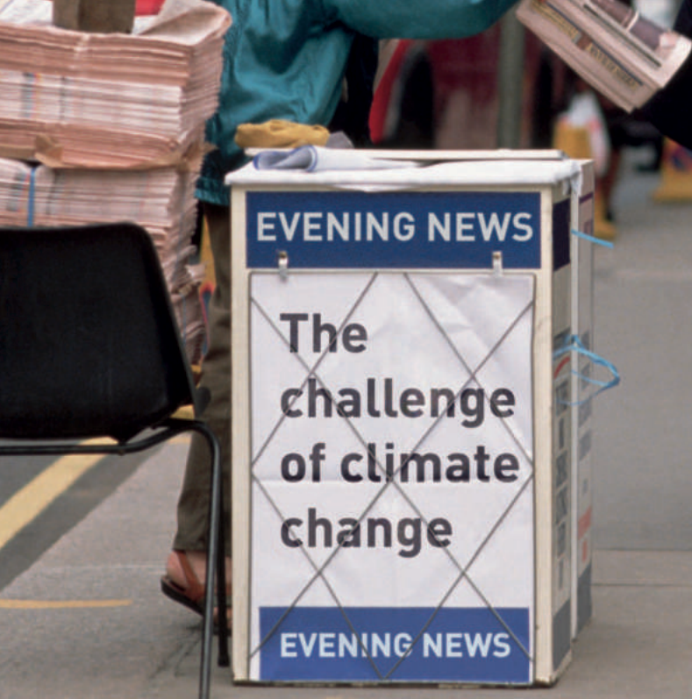

https://youtu.be/u0QRcFuT2Sg

Slide 2
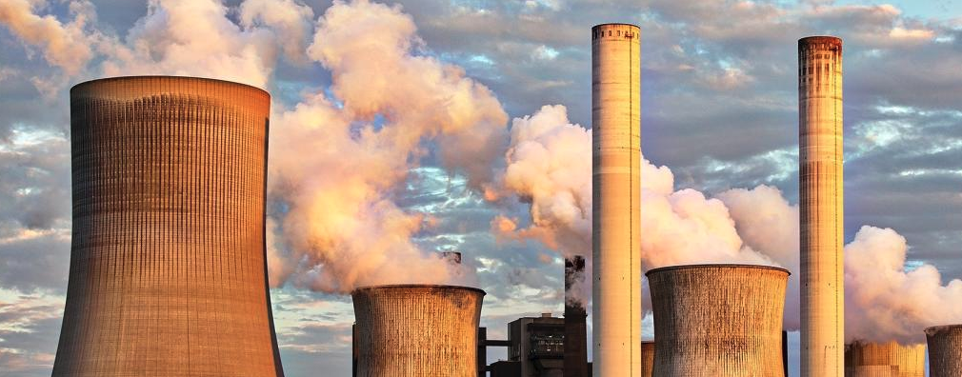
LOOK AT DATA AVAILABLE TO STUDY AND VISUALIZE HOW COUNTRIES ARE PROGRESSING AGAINST PARIS CLIMATE AGREEMENT PLEDGES
A low-carbon economy (LCE), low-fossil-fuel economy (LFFE), or decarbonised economy is an economy based on low carbon power sources that therefore has a minimal output of greenhouse gas (GHG) emissions into the atmosphere, but specifically refers to the greenhouse gas carbon dioxide.

Slide 3

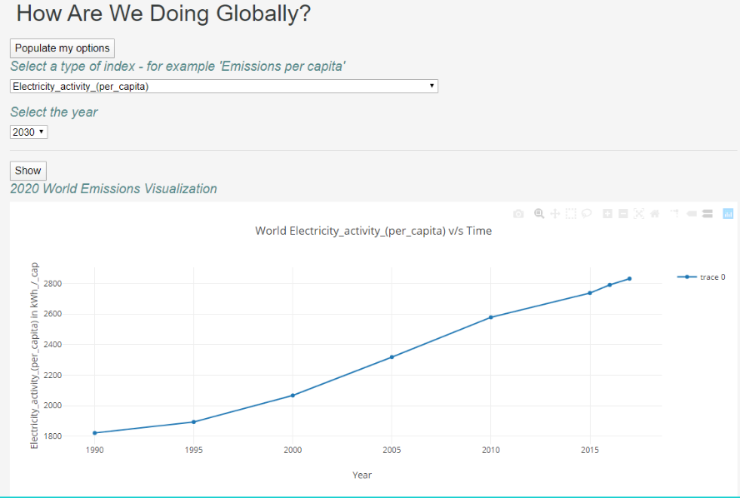
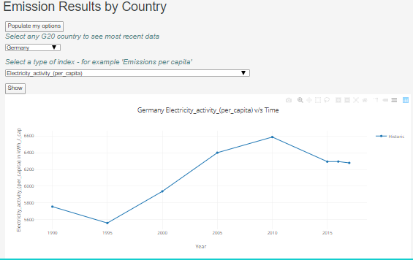
Climate change is real
Data source: :https://climateactiontracker.org/data-portal/?country=US&sector=Macro&indicator=Emissions%20per%20capita&scenario=historic&mode=indicators

Slide 4
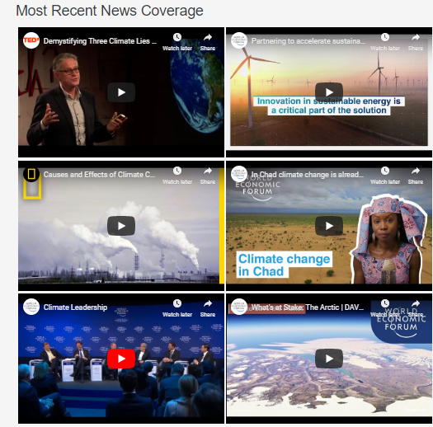
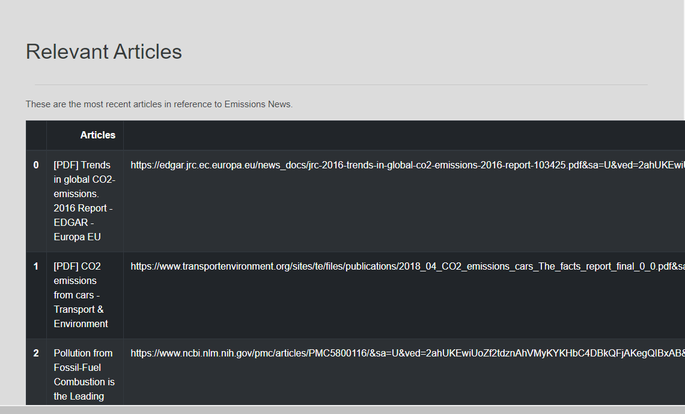
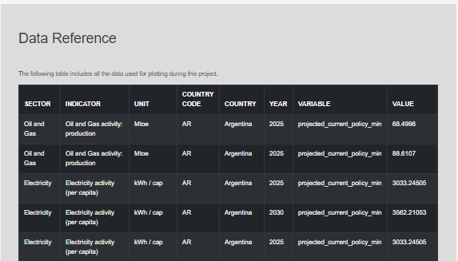
Climate change is real

Slide 5
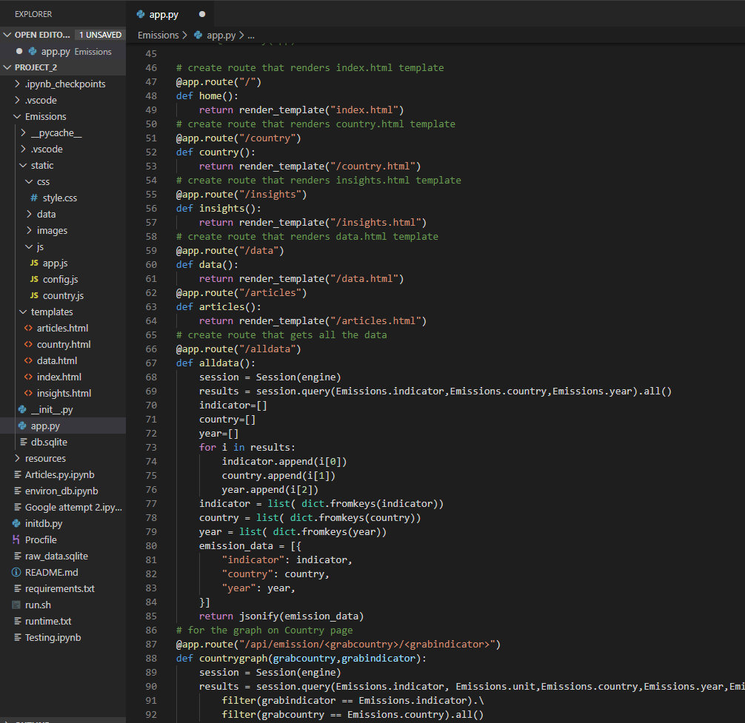
Climate change is real

Slide 6
Project 2 Requirements
Your visualization must include a Python Flask–powered RESTful API, HTML/CSS, JavaScript, and at least one database (SQL, MongoDB, SQLite, etc.).
Your project should fall into one of the below four tracks:
A custom “creative” D3.js project (i.e., a nonstandard graph or chart)
A combination of web scraping and Leaflet or Plotly
A dashboard page with multiple charts that update from the same data
A “thick” server that performs multiple manipulations on data in a database prior to visualization (must be approved)
Your project should include at least one JS library that we did not cover.
Your project must be powered by a data set with at least 100 records.
Your project must include some level of user-driven interaction (e.g., menus, dropdowns, textboxes).
Your final visualization should ideally include at least three views.

